Slide 1
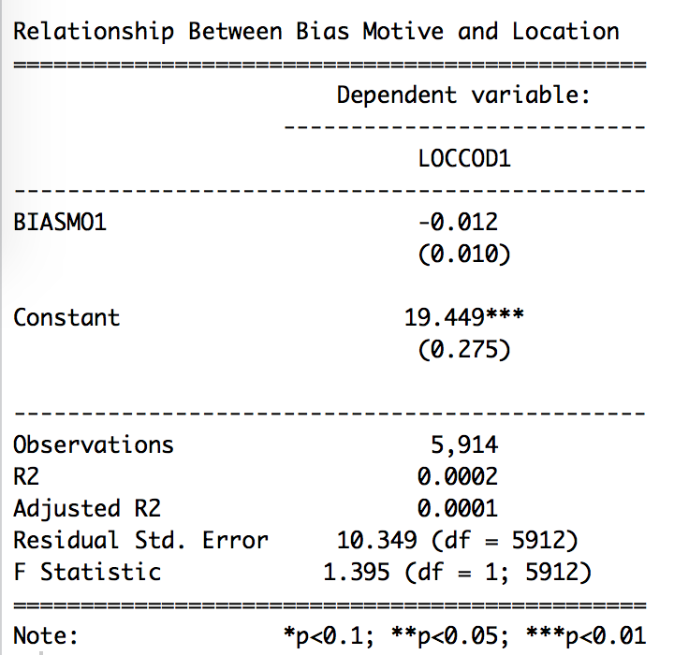
Research Question:
Are the trends in hate crimes within the US the same or different after 11 years?
What are the variables to a hate crime that predict its occurrence, specifically the bias motivation?
Data:
Histograms
Both data sets from 2002 and 2013 are collected by the attorney general as part of the Uniform Crime reporting act . Law enforcement agencies contribute reports to their state reporting programs and then give it to the DOJ for collection. The structure of each data set is constructed as the rows being the incident reports listed within the US and the columns are all the variables of each incident which are both categorical and numeric. The first variables are city, state, and population of the city and then descriptive variables that tell us about the crime. The subset data that I worked with have 9 variables that describe the city, state, population, total number of victims within that incident, total number of offenders, race of the offenders, the bias motivation behind the crime, victim type, and the location of the crime. The majority of this data is categorical where each level is assigned a dummy variable (code number) but the total number of victims and offenders is numeric.
simple (bivariate) linear regression:
I used the regression model to see if there is a correlation between the bias motive and the location of the crime This data lists the p-value, F-statistic, and standard of error. I looked at the p-value to determine the level of relationship these two variables have.
Hate Crimes in the United States in years 2002 and 2013
Yana Georgiana Chakalo
Background:
Due to the increase of hate crimes within the US around the 1990’s the US Justice Department made into law that every year reported hate crimes in every jurisdiction within each state must provide the data of these hate crime incidents. This project takes this nationally acquired data to look at the trends of hate crimes in America. Since we know that racism and sexism are still alive within our culture, especially, within this political climate we need to continue to look at why and under what circumstances do people commit these crimes. Through these understanding we can develop solutions for the future.
Methods:
The method I chose to analyze this data is through histogram frequencies for each variable because this will show each level within a categorical variable and its frequency all being compared with each other in years 2002 and 2013. This method is the best with how many levels that each variable has as well as the best and most simple way of visually comparing hate crime trends between each year.
In order to look at the statistical significance between two of my variables I developed a simple (bivariate) linear regression on the relationship between the bias motive and the location of the hate crime. I then called for a summary of the results and created a table to show the results. This let me look at a primary relationship between two variables that were part of my theories on hate crimes.
Findings:
Through these histogram visualizations I was able to look at static trends between different variables. What I found for the type of bias motivation is that the overall cases of hate crimes are down but the type of bias motivations that occurred are overall the same from 2002 to 2013. For the location of where the hate crime took place the trend shift is still pretty similar, however, there are distinguishable differences. In 2002 the school/college location was around 700 cases but in 2013 it was around 300 cases showing a decline in hate crimes occurring on campuses. Another interesting occurrence is that in 2013 there was an added location which had a bigger significance than I thought and that is hate crimes committed at military installations. Lastly, for the hate crime rate in each state the trend between 11 years is also very similar in which, California and New York are the highest, for possibly three reasons. First, these states have the highest populations possibly causing a higher occurrence, or these states have the most reported hate crimes to police and other states do not report, or these states do have the highest hate crimes in the US because they have the two biggest cities in the US. For the statistical analysis regression these findings show that the bias motive and the location of the crime do have a significant relationship because the p-value is smaller than 0.01 meaning that there is some significance between how the bias motivation determines the location of the crime.

